Slide 1
Retail Sales Analysis & Forecasting Project
Analyzing Superstore Sales Data to Drive Business Growth
Tony Kumar Bodhimisetty, APRIL 2025

Slide 2
Project Overview
Content:
Analyzed sales data from a large retail superstore
Uncovered trends, patterns, and customer behavior
Built interactive dashboards to visualize insights
Forecasted future sales using time-series modeling
Provided strategic recommendations to boost sales

Slide 3
Project Objectives
Content:
Clean and preprocess the raw dataset
Perform exploratory data analysis (EDA)
Create interactive sales dashboards (Power BI)
Forecast future sales (12 months ahead)
Recommend actionable strategies for growth

Slide 4
Tools & Techniques
Content:
Excel – Initial exploration
SQL – Data querying
Python (Pandas, NumPy, Matplotlib) – Data cleaning, EDA
Power BI – Dashboard creation
Google Sheets – Collaboration

Slide 5
Data Cleaning
Content:
Removed missing values (Postal Codes)
Corrected datatypes (Order Date, Ship Date)
Handled duplicate entries
Ensured consistency across all fields

Slide 6
EDA highlights
Content:
Sales increased significantly during Q4 each year
Technology and Office Supplies are top-selling categories
Corporate and Consumer are best customer segments
West and East regions generate maximum revenue

Slide 7
Visualizations
Content:
Interactive KPIs: Sales, Orders, Average Sales per Customer
Regional Sales Map
Category and Sub-category performance charts
Monthly sales trends

Slide 8
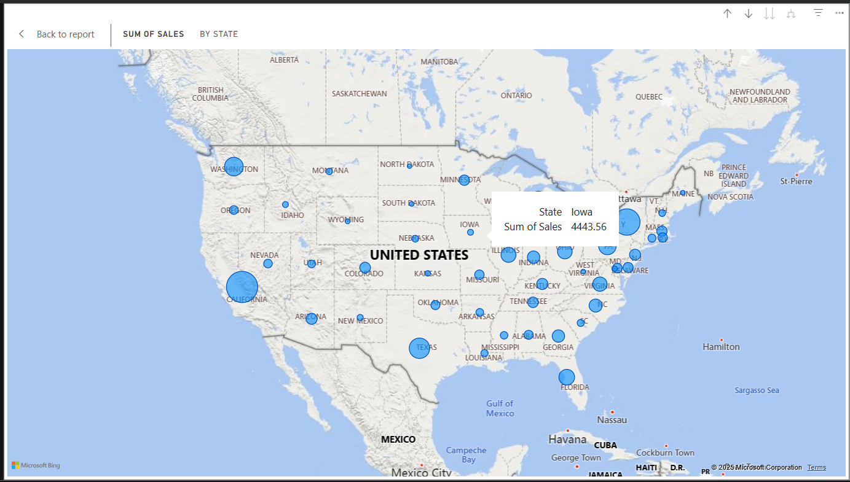
Regional Sales Map

Slide 9
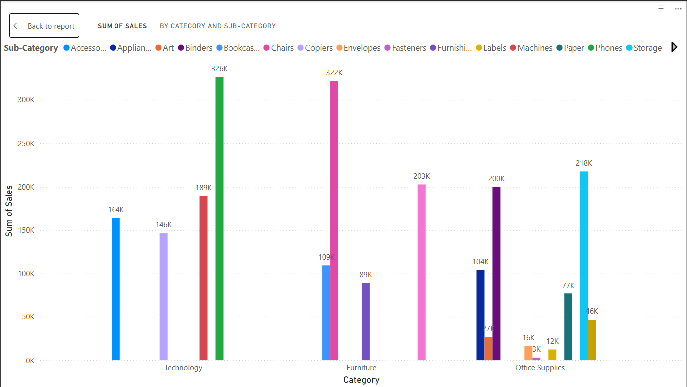
Category and Sub-category performance charts

Slide 10
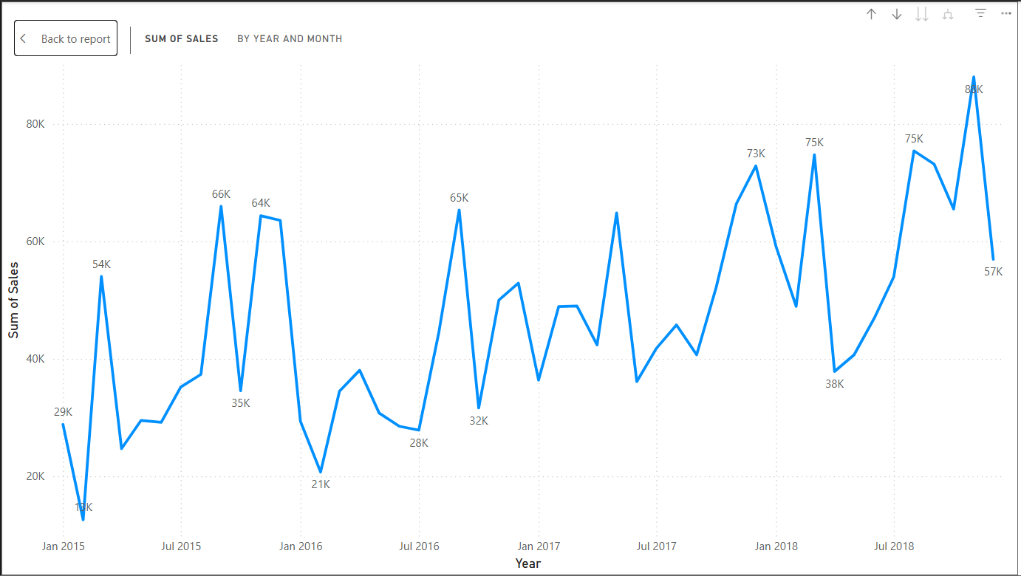
Monthly Sales trend

Slide 11
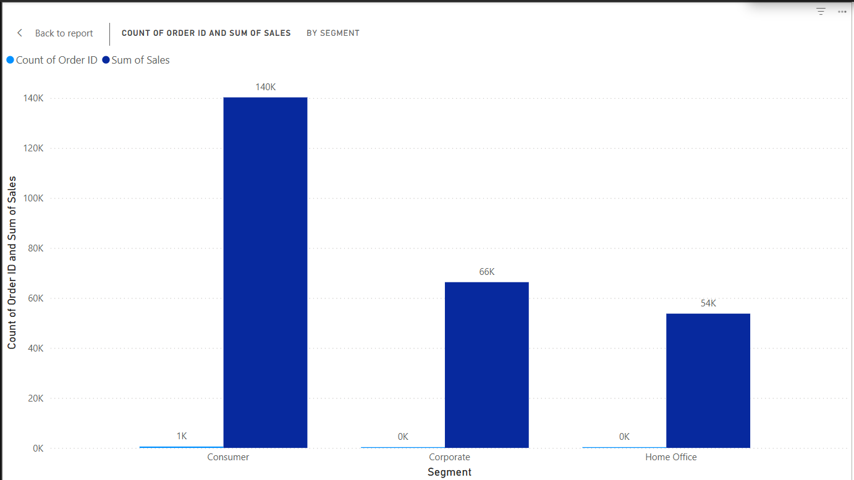
Segment performance chart

Slide 12
Forecasting Future Sales Sales Forecasting (SARIMA)
Content:
12-month forecast built using SARIMA model
Predicted continued sales growth with Q4 seasonal peaks
Model trained and validated using historical data

Slide 13
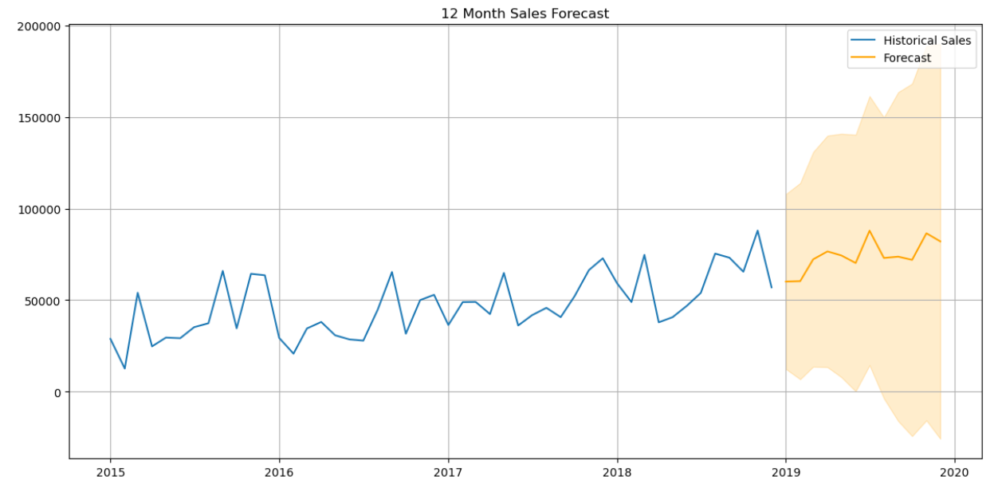

Slide 14
Key Insights
Content:
Strong seasonal sales spikes in Q4
High-performing segments: Technology & Corporate
Western region drives most revenue
Faster shipping methods improve sales conversion

Slide 15
Strategic Recommendations
Content:
Boost inventory during peak months
Focus marketing on top regions (California, New York)
Promote Technology products aggressively
Offer mid-year promotions to stabilize slow periods
Optimize shipping offers to increase order size

Slide 16
THANK YOU
Project by : Tony Kumar Bodhimisetty
Connect with me : www.linkedin.com/in/tony-kumar-bodhimisetty-02a1a625a
Full project : https://github.com/TONY081/Retail_sales_analysis.git

